Slide 1

UniSched – University Course Timetabling System
Gal Moyal
Eden Furman
Advisor:
Dr. Julia Sheidin
Dr. Avital Shulner Tal
Code: 26 – 1- D -13
1
Notes:
Hello, today we will present the first phase of our capstone project.
The project is called UniSched – University Course Timetabling System.
Our supervisors are Dr. Julia Sheidin and Dr. Avital Shulner Tal.
This system is designed specifically for the Software Engineering department at Braude College.
Today, course scheduling is done manually, which is complex and inefficient.
In this presentation, we will briefly introduce the problem and our proposed solution.
עדן

Slide 2
Background & Current Situation
Manual timetable creation
Many constraints
Time-consuming and error-prone
Notes:
First, it is important to understand what a course timetable is and how it is created today.
A course timetable defines when and where each course is taught during the academic semester.
In the Software Engineering department at Braude College, the timetable is built manually by Ora, the department secretary.
Like in many institutions, this process is done using Excel files.
The timetable must match courses, lecturers, rooms, and time slots, while considering many constraints and preferences.
As a result, this process is time-consuming, inefficient, and prone to human errors.
עדן

Slide 3
Problem Definition
Problem grows
Manual scheduling using Excel
Handle many different constraints
3
Notes:
After understanding how the timetable is created today, we can see that this approach does not work well as the problem grows.
Manual scheduling using Excel becomes difficult when the number of courses, lecturers, rooms, and time slots increases.
Therefore, we need a solution that can handle many different constraints, coming from courses, lecturers, classrooms, and time availability,
in a structured and reliable way.

Slide 4
Existing Solutions & Limitations
Manual tools
Simple rule-based systems
Algorithms
Notes:
Today, there is no single solution that fits all academic institutions for the course timetabling problem.
This is because the problem varies between institutions, and each department has its own constraints and rules.
As a result, there are different types of existing solutions.
One approach is manual scheduling, which is currently used in our department.
Another approach includes general scheduling systems, such as employee shift scheduling.
These systems can inspire our solution, but they are not sufficient on their own for academic scheduling, since they do not fully support constraints such as
course dependencies.
There are also algorithmic approaches that try to solve the problem, but they must be adapted to the specific constraints of each institution.
עדן

Slide 5
Project Goals
Full system
Minimize conflicts
Improve usability
Generate valid schedules efficiently
5
Notes:
The goal of this project is to design a system that creates a valid and reasonable course timetable.
First, the system must avoid impossible schedules, such as overlapping courses or assigning unavailable lecturers.
Beyond that, the system aims to reduce less desirable situations, for example scheduling a lecturer for only one lecture in a day.
Overall, the goal is to produce a timetable that is both feasible and more convenient for lecturers, students, and the department.
גל

Slide 6
Communication with the Client
Constraint extraction
Understanding the scheduling process
Understanding system requirements and limitations
Notes:
At the beginning of the project, our first step was to communicate with Ora, the department secretary.
The goal was to understand how the scheduling process works today and what the main goals of our system should be.
In order to design the system, we worked with her to identify the different constraints that the timetable must satisfy.
In addition, we asked Ora to explain how she currently performs the scheduling, so we could recreate the same logic inside our system.
גל

Slide 7
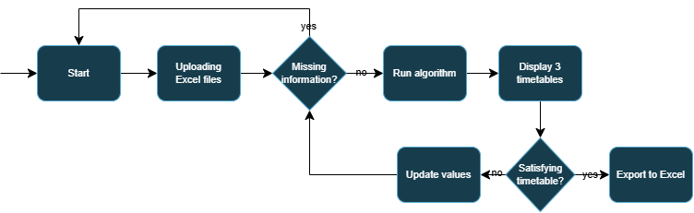
Proposed Solution Overview
Notes:
Based on the requirements and constraints we identified, we propose an automated course timetabling system.
The system receives input data such as courses, lecturers, rooms, and time availability.
Using this information, the system generates three different timetable options, in order to present several alternative solutions that Ora can choose from.
We also understood that Ora needs the ability to adjust the input data and the constraints according to the department’s needs.
For example, she can increase or decrease the weight of different constraints.
By doing so, she can control how much each constraint is considered in the final timetable.
Therefore, the system includes a user interface that enables manual editing of data and constraints directly from within the system.
גל

Slide 8
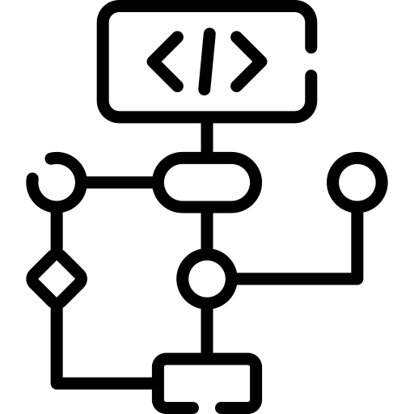
The algorithm - CSP
Variables – lessons
Domains – time slots & rooms
Constraints – conflicts, availability
Cost function - preferences
Notes:
Now we will talk about the heart of our system – the algorithm.
We chose to use a CSP algorithm, which means a Constraint Satisfaction Problem.
We chose this algorithm because we think it can give us good results.
We needed an algorithm that can handle different constraints and also use heuristics to reduce the search space.
In this algorithm, the first step is to define the variables.
We chose the lessons as our variables – each lesson needs to be scheduled.
The domain is the time slot and the classroom.
For the constraints, we divided them into two types: hard constraints and soft constraints.
A hard constraint is a constraint that must be satisfied, otherwise the schedule is not valid.
A soft constraint represents preferences that we want the system to consider.
Based on the soft constraints, we calculate a cost function.
The cost function gives a score to each schedule – the lower the score, the better the schedule.

Slide 9

Heuristics
Forward Checking
Value Ordering:
  Variable Ordering Heuristic
  MRV – Minimum Remaining Values
  Weighted Value Ordering (Cost-Based Value Choice)
Notes:
The scheduling problem has a very large search space, because there are many possible combinations of lessons, rooms, and time slots.
To handle this, we use heuristics that help guide the search process.
These heuristics help the algorithm decide which variable to assign first and which values to try first.
By using heuristics, the system can find good solutions faster and avoid unnecessary backtracking.
The Variable Ordering Heuristic is a heuristic we developed ourselves, based on our work with Ora.
It follows the same logic she uses when manually building the timetable.
Backtracking is used when the algorithm reaches a conflict.
It allows the system to go back and try a different assignment.
Forward Checking helps detect conflicts early.
After assigning a value, it removes invalid options from future variables.
MRV – Minimum Remaining Values selects the variable with the fewest valid options left, in order to reduce the chance of failure later.
Weighted Value Ordering, also called cost-based value choice, prefers values that minimize the total cost, based on the defined preferences.
Together, these heuristics allow the system to produce solutions that are not only valid, but also better and more balanced timetables.
עדן

Slide 10
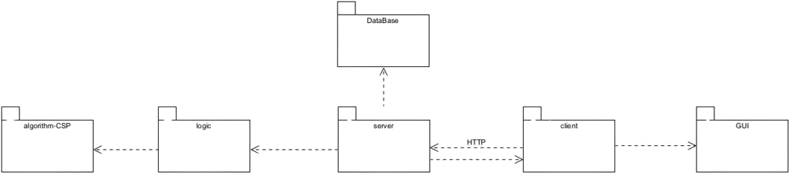



System Architecture
Notes:
The system will be built using a client–server architecture.
The server side will be implemented in Java
and will be responsible for running the CSP algorithm
and handling all scheduling logic.
The client side will be implemented using JavaScript with React,
and will provide the user interface for the system.
In addition, the system will use a cloud-based database
to store input data, constraints, and generated timetables.
This separation between server, client, and database
will make the system easier to maintain, update, and extend.
עדן

Slide 11
User Interface
Import Excel files
Edit lecturers, courses, rooms
Generate timetable
Visual validation indicators
11
Notes:
The user interface will be designed
for a non-technical user,
mainly the department secretary.
Through the interface, Ora will be able to
upload and edit input data
such as courses, lecturers, rooms, and availability.
She will also be able to
adjust constraints and change their weights
in order to influence the generated timetable.
After running the algorithm,
the interface will present three different timetable options,
allowing easy comparison and selection.
In addition, Ora will be able to
export any selected timetable option to an Excel file.
עדן

Slide 12
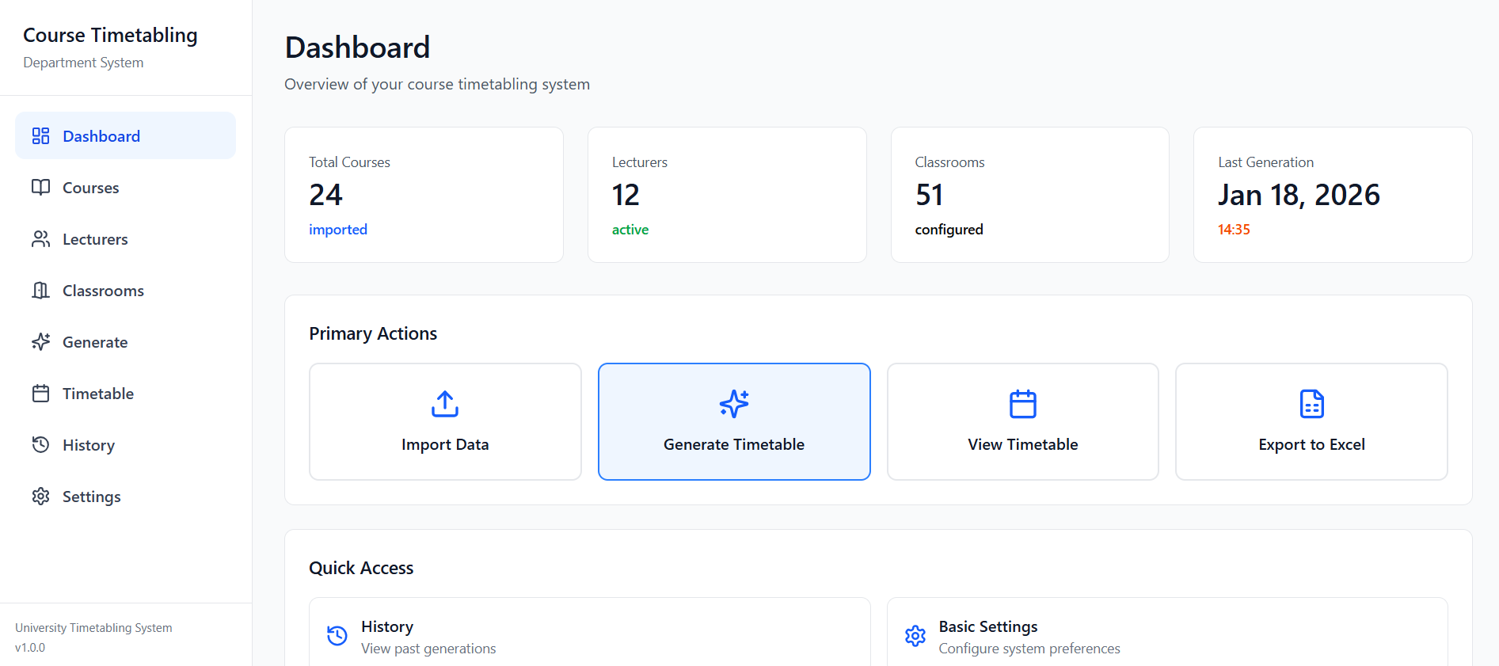
Dashboard
Notes:
This slide shows the dashboard, which is the main screen of the system.
From this screen, we can see what we can do in the system.
There are buttons to upload data, generate a timetable, and view the timetable.
From the dashboard, we can also move to other screens.
In addition, this screen shows general information, such as the total number of courses, lecturers, and classrooms.

Slide 13
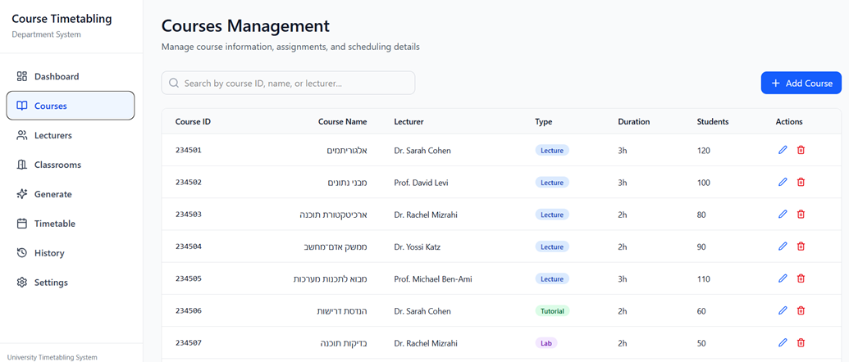
Courses
Notes:
This slide shows the course screen.
In this screen, we can see information about each course.
This includes the course code and course name, who teaches the course, and the course type, such as lecture, tutorial, or lab.
We can also see how many hours the course has and how many students are registered.

Slide 14
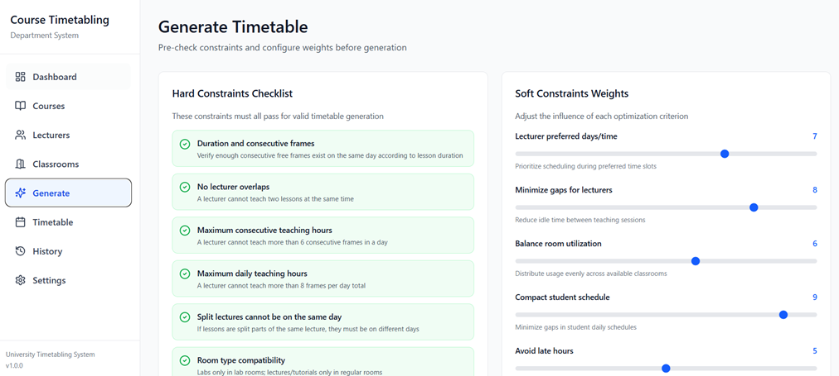
Generation screen
Notes:
Here you can see how our Generation screen looks.
On the left side, we have a list of hard constraints.
For each constraint, we can choose whether it will be considered or not by selecting it from the list.
On the right side, we have the soft constraints.
For each soft constraint, we can choose how much the system should consider it.
For example, if we currently prefer a schedule without gaps, we can give this constraint a higher weight,
and then it will have higher importance.

Slide 15
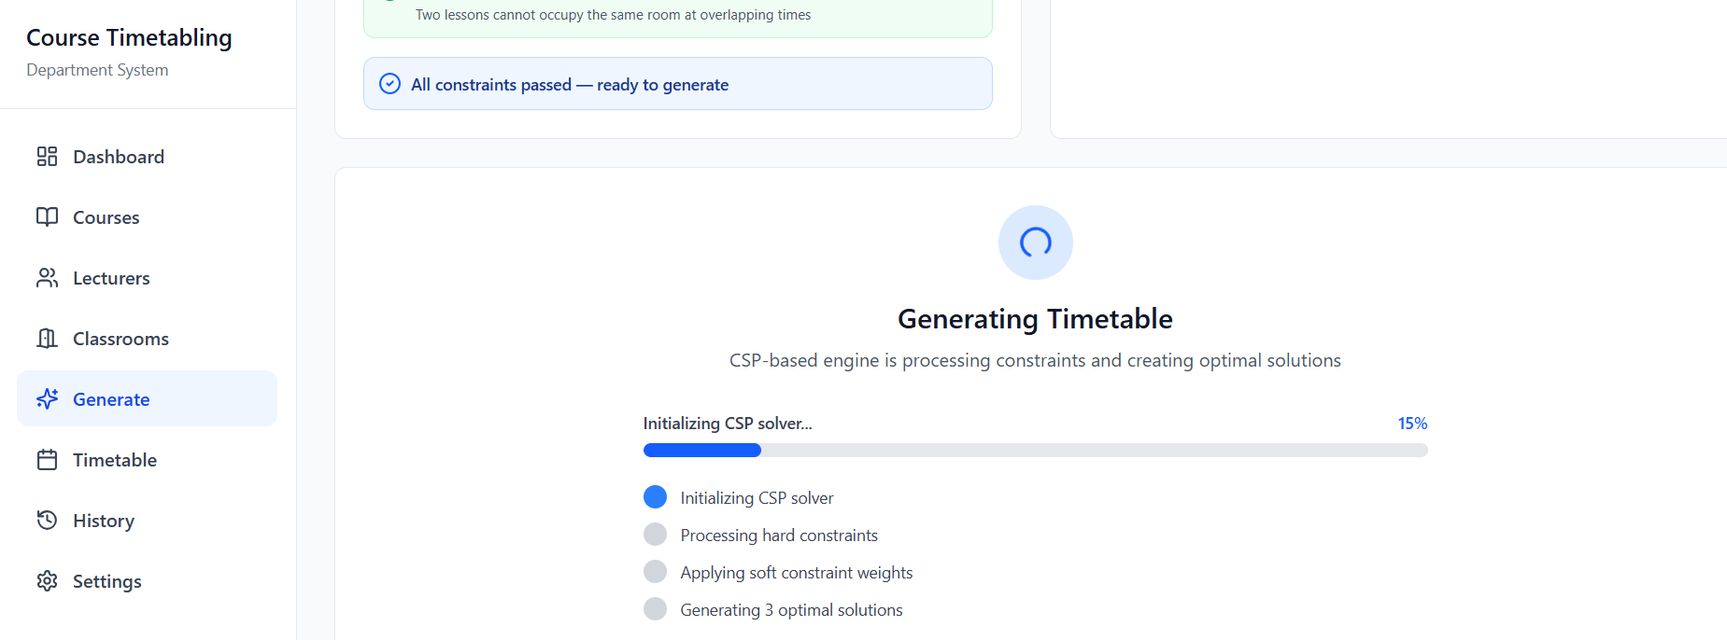
Generation screen
Notes:
At the bottom of the same screen, there is a button.
After clicking it, a progress bar will appear.
Since running the algorithm and creating the schedule is not an immediate process, it is important for us to give feedback to the user, so they can see the progress.

Slide 16
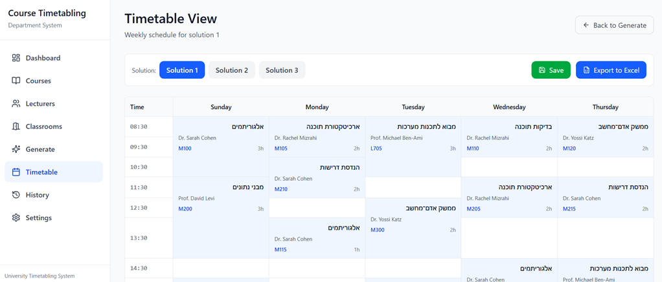
Timetable screen
Notes:
Here we can see how the scheduling screen will look.
The schedule is displayed in a clear and user-friendly visual way, and there is also an option to view all the different schedules that the algorithm generates.
For each schedule, we can save it in the system and also export it to an Excel file.

Slide 17
Testing Plan + Success Metrics
Functional tests
Constraint validation
Usability testing (SUS questionnaire)
17
Notes:
The system will go through standard functional testing, to ensure that all features work correctly and that the generated timetables are valid.
In addition, we will evaluate the quality of the scheduling results, to check that the solutions are not only feasible, but also practical and useful.
Beyond technical testing, we will perform user-centered testing together with Ora.
During this process, we will present the different system stages, observe how the system is used, and make sure it is simple, clear, and accessible.
Finally, Ora will be asked to complete a SUS questionnaire along with additional questions, in order to measure usability and overall satisfaction.
גל

Slide 18

Challenges
Unforeseen constraints may arise during implementation
The model may require refinement and adjustment
System limitations affect long-term data handling
18
Notes:
During the development, we expect several challenges.
The first challenge is that during development, new constraints may appear that we did not think about before.
In addition, there will probably be a need for refinement and adjustment based on using real data and receiving feedback from users.
Also, because we use a cloud database – Firebase – its free plan is limited. Therefore, we need to take this into account and ask users to occasionally delete saved schedules from the system.
גל

Slide 19
Summary
course timetabling problem
reviewed existing solutions
introduced our proposed solution
19
Notes:
In this presentation, we introduced the course timetabling problem and explained how it is handled today.
We presented the challenges of manual scheduling and reviewed existing solutions and their limitations.
We then introduced our proposed solution, based on a CSP model with heuristics, designed to produce valid and high-quality timetables.

